Slide 1


AWS Aurora Kole Vasilevski, Principal Software Engineer

Slide 2
AWS Relational Database Service ( AWS RDS )
Supports industry-standard relational databases Aurora, MySQL, MariaDB, PostgreSQL, Oracle, Microsoft SQL Server.
RDS manages backups, software patching, automatic failure detection, and recovery.
Basic building block of RDS is the DB instance, which is an isolated database environment in the cloud. Each DB instance runs a DB engine. You can select the computation and memory capacity of a DB instance, determined by its DB instance class.
You can run your DB instance in several AZs, an option called a Multi-AZ deployment. Amazon automatically provisions and maintains a secondary standby DB instance in a different AZ.

Slide 3
Aurora
A fully managed (serverless) relational database engine that’s compatible with MySQL and PostgreSQL.
Scales automatically, perform faster, and coast lower that other databases.
With some workloads, Aurora can deliver up to five times the throughput of MySQL and up to three times the throughput of PostgreSQL.
Deployed as a database cluster that consist of Primary DB instance and Aurora Replica
An Aurora cluster volume is a virtual database storage volume that spans multiple AZs, with each AZ having a copy of the DB cluster data.
Aurora is fault-tolerant and self-healing.

Slide 4
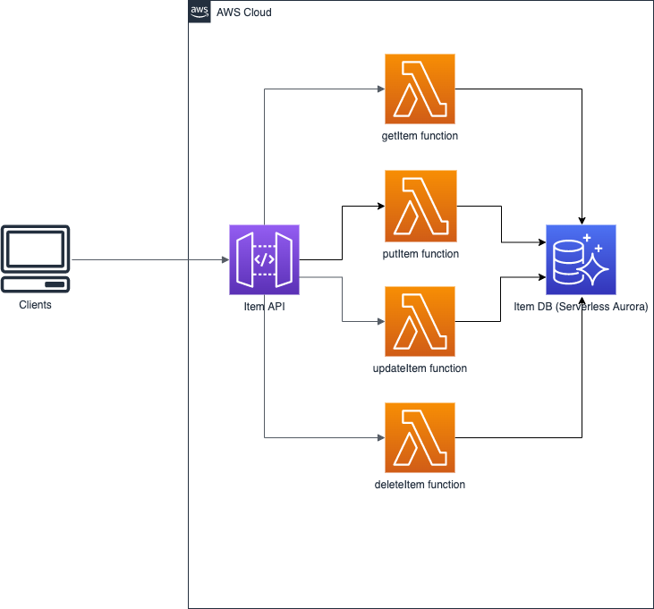
Serverless application API Gateway - Lambda - Aurora

Slide 5
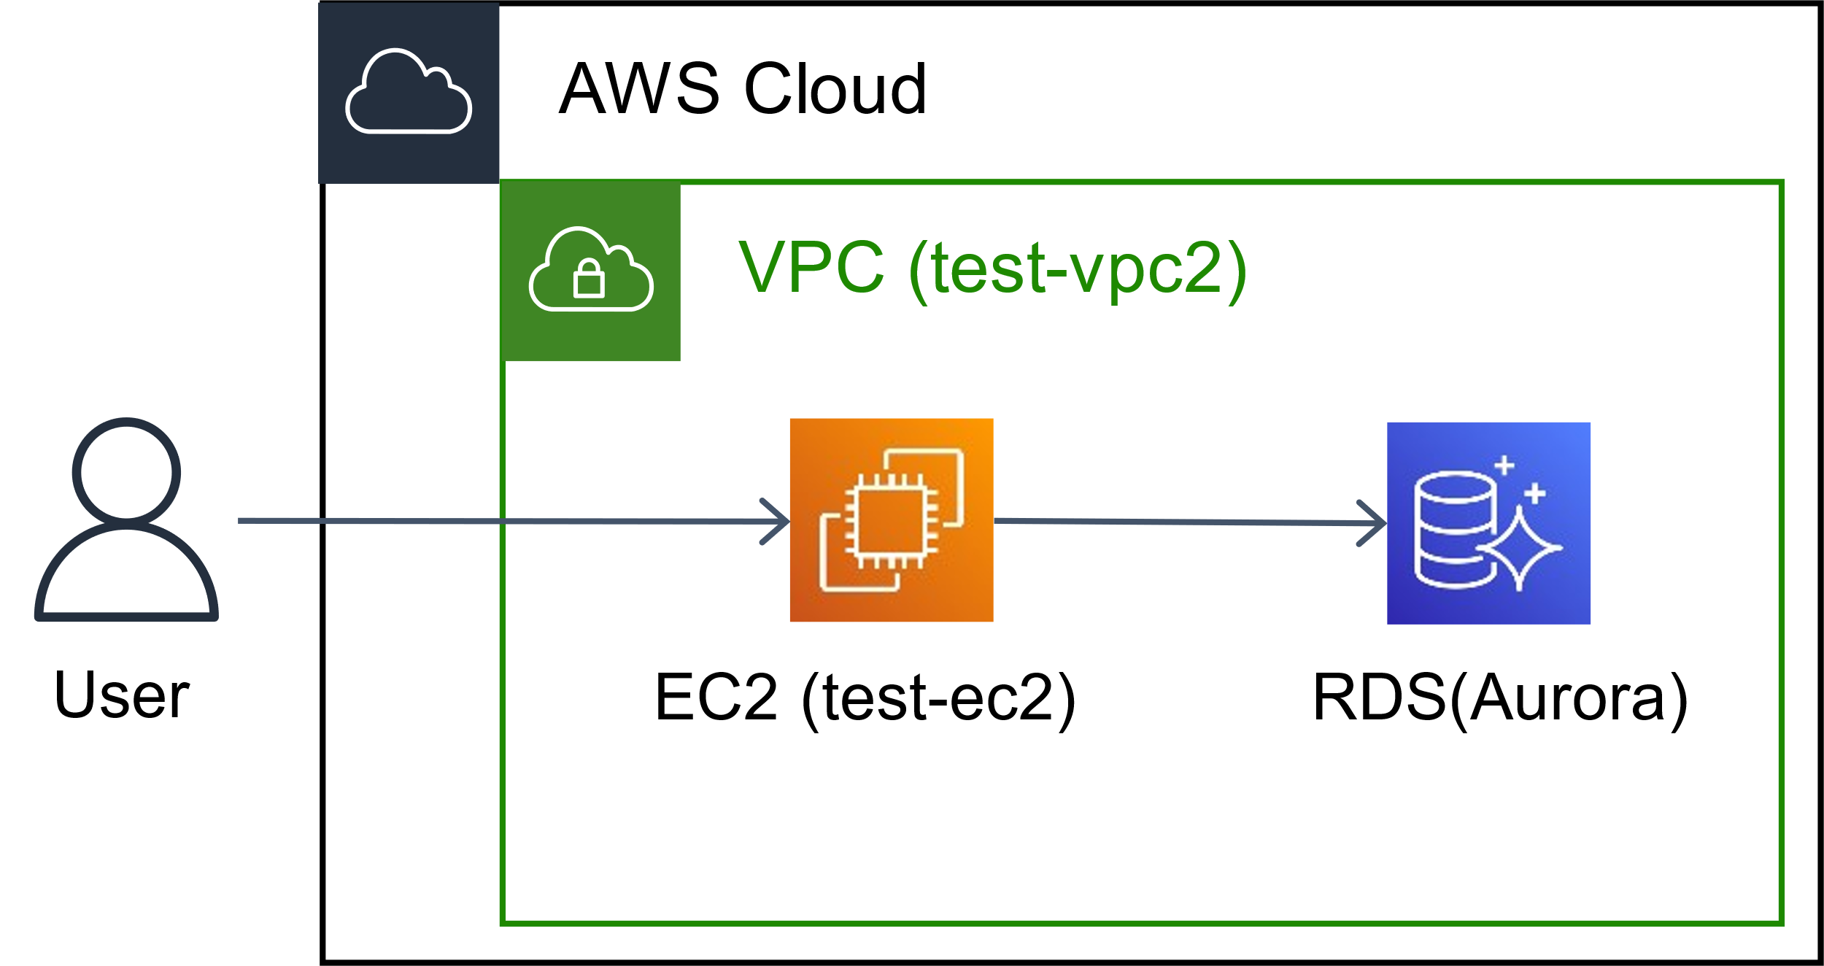
Serverless application EC2- Aurora

Slide 6

Aurora Demo in AWS Console

Slide 7

Aurora Demo .NET Code

